Slide 1
Research Internship
Medical Imaging and Theragnostic Lab, IIT Kgp
Project Title: “AgrIndia: AI Assisted Detection of Chlorophyll Content in Leaves of Food crops using spectral signatures.”
Presented By : Shourya Gupta
Department of CSE, MIT Manipal

Slide 2
AgrIndia
The AgrIndia project focuses on deployment of plant phenotyping and disease detection models using a handheld multispectral imager. In the proposed sub- project entitled “AgrIndia: AI-assisted Detection of chlorophyll content in leaves of food-crops using spectral signatures”, the goal is to unmix three coloured images acquired by the imaging system and provide a chlorophyll mapped image of the region of interest.
Digital imaging methods are used for mapping chlorophyll content of leaves and identifying any diseases present in crops using the multi- spectral images of leaves acquired by handheld device. Accurate measurement of chlorophyll will help in determining the nitrogen deficiency and recommend the correct usage of fertilisers.

Slide 3
Spectral Unmixing
Spectral unmixing is the process by virtue of which a mixed image pixel is segregated into various constituent “endmembers,” along with coefficients indicating the abundances or fractions of the endmembers present in the image pixel.
It generally consists of two major steps, the endmember identification and extraction and computing abundances of the endmembers pixel-wise.

Slide 4
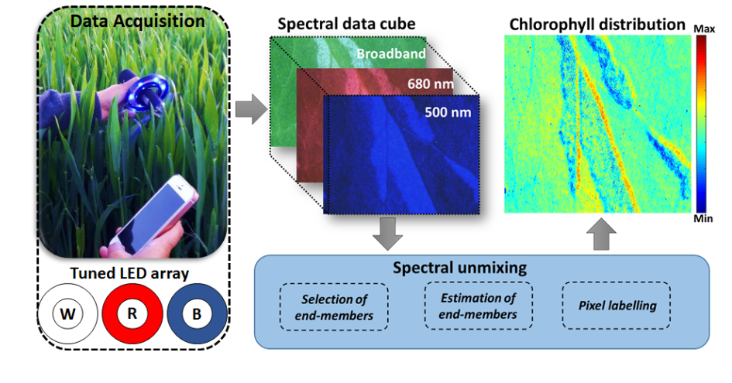
Project Pipeline
Figure 1: AgrIndia Project Pipeline

Slide 5
Multispectral unmixing implies application of multiple channels or spectral bands to extract and estimate endmembers from a given multispectral image. The project pipeline comprises the following steps:
Data Acquisition of three channels or spectral bands of the plant image at wavelengths of 680 nm, 500 nm and Broadband.
AI Algorithm to select endmembers and subsequent estimation and pixel labelling
Chlorophyll A and B abundance maps

Slide 6
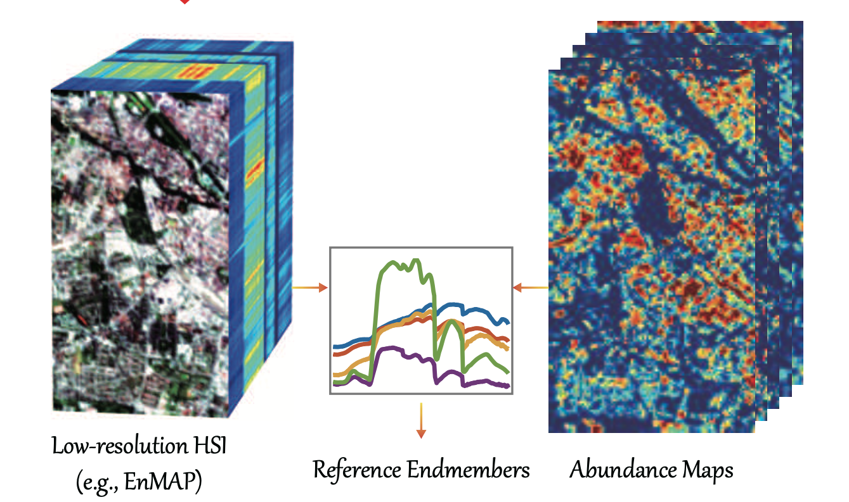
Example of Abundance Maps (EnMap Dataset)
Figure 2: A Typical Example of Endmember Estimation and Abundance Mapping [1]

Slide 7
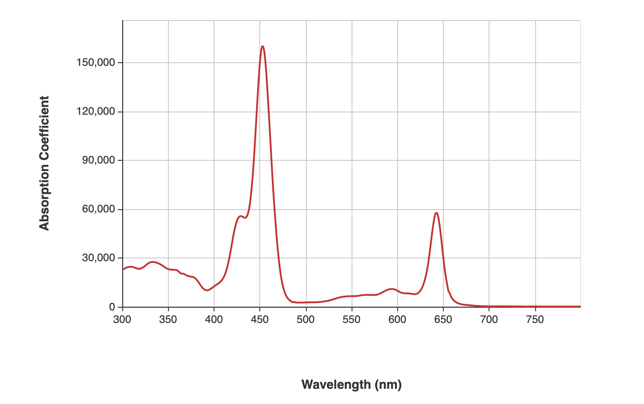
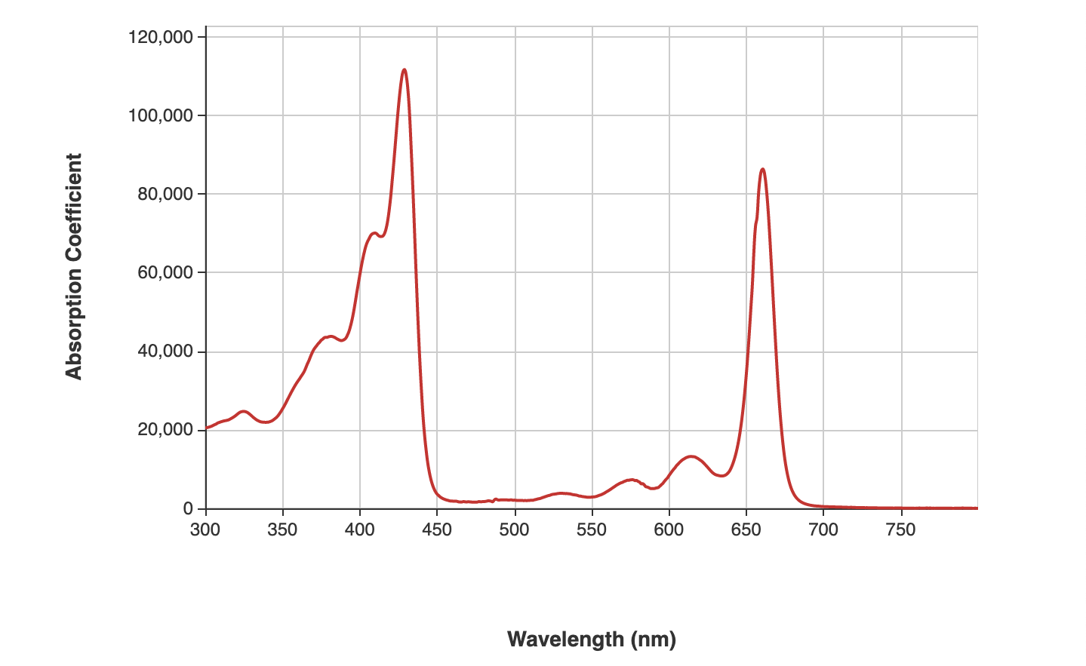
Chlorophyll A and B signatures
(a) (b)
Figure 3: Spectral Signatures for Chlorophyll A (a) and Chlorophyll B (b)

Slide 8
Literature Review: Summary
LMM (Linear Mixing Model) is one of the most basic methods applied for Spectral Unmixing. However, it has various shortcomings , such as , it does not do well for spatially interacting endmembers.
Bilinear and Multiple Endmember Bilinear Models which extend the mixing equation used in the Bilinear Models to more than two endmembers. Yet, they do not take into account various physical phenomena such as Multiple Scattering Effects and water-absorbing environments.
Machine Learning and related fields, such as deep learning (DL), have been chosen to solve the problem of Spectral Unmixing to build more robust and generalized models.
Various models such as Autoencoder-based methods, belief networks, ANNs CNNs and many custom architectures have also been proposed for the SU problem.

Slide 9
The AgrIndia Dataset
The provided dataset consists of about 220 Multispectral Images of leaves of plants from the Poaceae family (rice, wheat, maize etc) scanned with the developed handheld device.
A Multispectral plant leaf image or a Hypercube comprises three channels or spectral bands, at the wavelengths of 680 nm, 500 nm and the Broadband light.
Hence, an image is of dimension rows ∗ columns ∗ (number of bands).

Slide 10
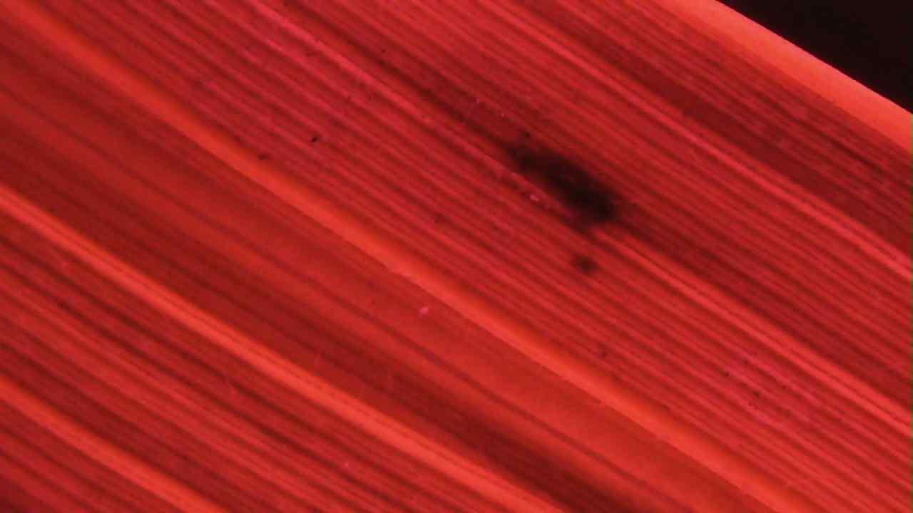
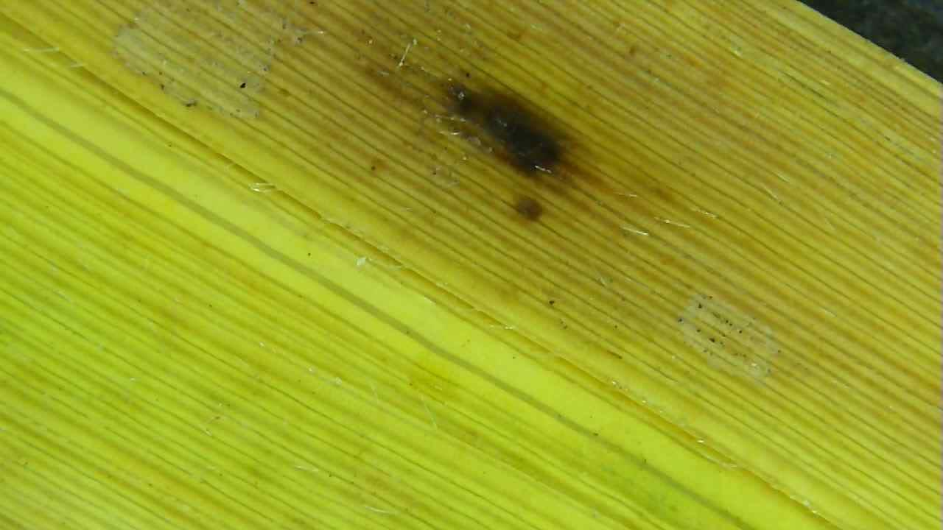
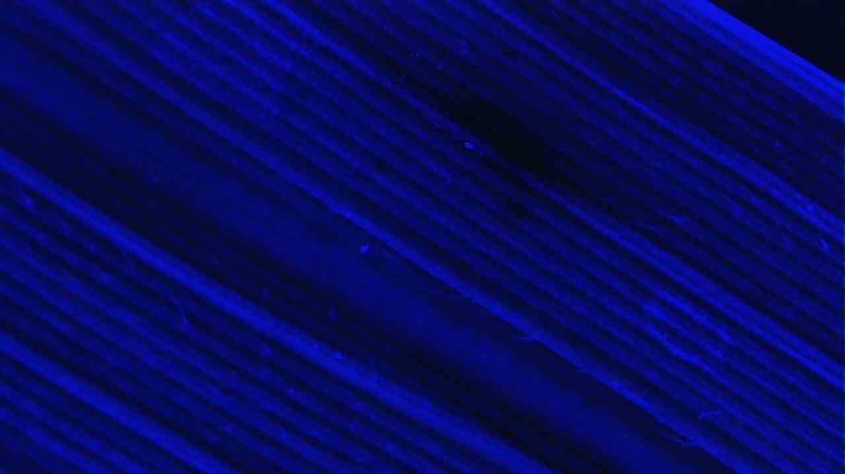
680 nm
Broadband
500 nm
Figure 2: Figure showing the three spectral bands of the multispectral plant image

Slide 11
For blind spectral unmixing, each spectral Hypercube is generally considered as the dataset used by the network for training. This implies that the number of pixels in the input image becomes critical.
Based on the exhaustive literature survey done for deep learning approaches to Spectral Unmixing, the images are generally resized to 200 rows by 200 columns, that is, 40,000 pixels. Here, each pixel is a mixed pixel from which endmember abundance fractions have to be estimated.

Slide 12
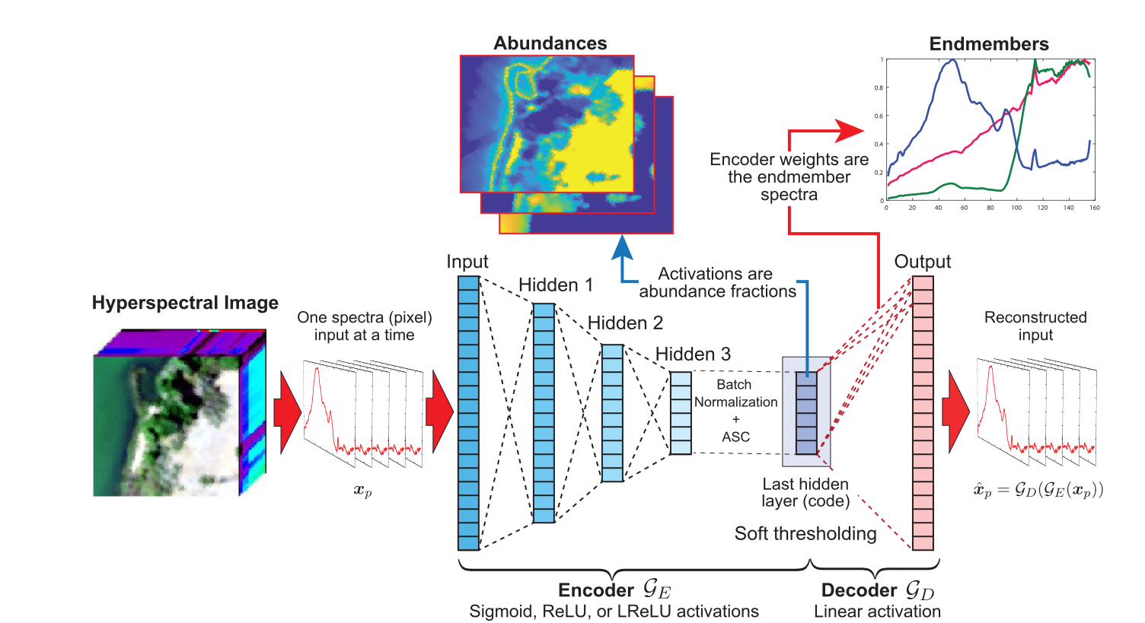
Autoencoder Based Network
Figure 3: The Autoencoder architecture followed [2]

Slide 13
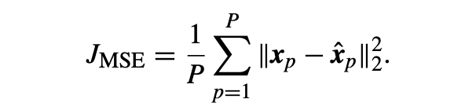
Objective Functions
MSE Loss:
(1)
where xp is the true spectrum and xˆp is the estimated spectrum for pixel p. || · ||2 denotes the Euclidean norm of a vector.

Slide 14
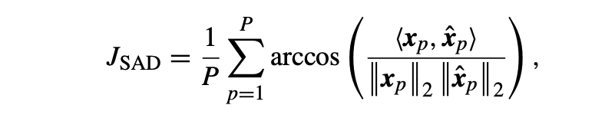
SAD Loss:
(2)
The SAD and measures the angle between spectra in their signal space in radians, where xp is the true spectrum and xˆp is the estimated spectrum for pixel p.

Slide 15
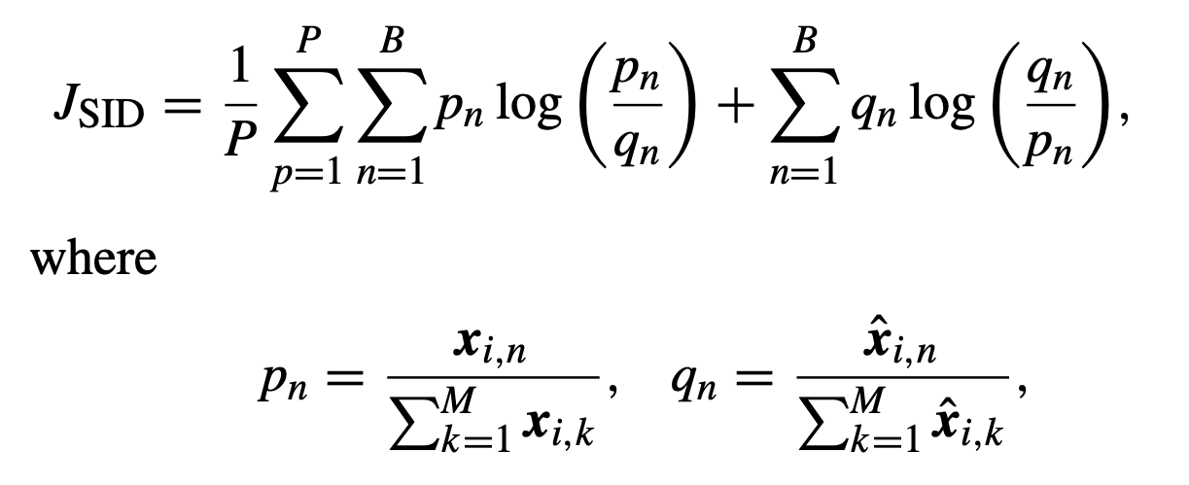
SID Loss:
(3)
are estimates of the probability mass functions of the target and estimated spectra, respectively.

Slide 16
Important Contributions
Simulation of Data
The literature review showed that unmixing tasks generally require spectral bands ranging from 100-250, along with simulation of artificial data. However, for the given problem statement , only 3 spectral bands are available.
To overcome this drawback, data simulation approaches were explored in order to create multispectral plant images similar to the given dataset. Specifically, GAN based approaches were explored to simulate data [3]. This approach is still a work in progress.

Slide 17
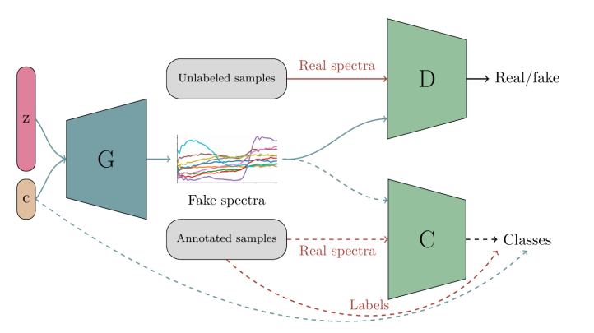
Figure 4: GAN architecture described in [3]

Slide 18
2. The 3 Point Loss Function
(4)
In this equation, Y is the tensor containing true spectral absorbance values of the Chlorophyll A and B endmembers , Yˆ represents the estimated values, and M and N are the number of spectral bands and number of endmembers respectively.
The idea of the 3 point measure is simple: take spectral absorbance values of ChlA and ChlB at the given three wavelengths and compare them with the estimated spectral absorbance values by the network.

Slide 19
The results were tested by adding the 3-point loss function to the reconstruction loss (SID/SAD).
Based on the experimental results during training, adding weights to the two loss functions has been suggested:
However, using this loss function did not give optimal results with the current base network.
Thus, it is suggested to include a sub-architecture into the base autoencoder in order to account for the 3-point measure to obtain accurate endmember signatures.

Slide 20
Reinforcement Layer
A tradeoff was observed between the accuracy of abundance maps and end member signatures predicted by the network.
In order to resolve this tradeoff, a Reinforcement Learning based approach was explored. This approach involves introducing an RL layer at the end of the network, which basically penalizes the network decoder weights by comparing with the true Chlorophyll spectra.
Hence, the network receives feedback in the form of rewards or penalties for its actions and learns to adjust its behavior accordingly to maximize the 3_point_measure over time.

Slide 21
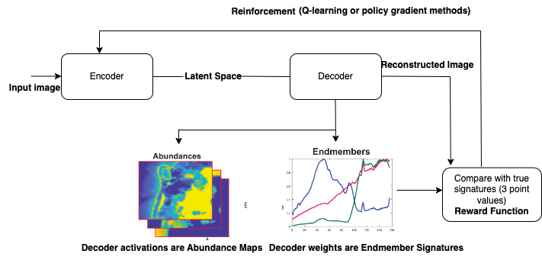
Suggested RL Layer

Slide 22
Results and Discussion
The performance of the network while training is evaluated using the MSE, SAD and SID objective functions. The function given as the argument for the network is assigned as the reconstruction loss.
The primary hyperparameters tuned for training include the number of epochs, the type of encoder( deep or shallow ), learning rate, gaussian dropout, and the activation function used in the network layers.

Slide 23
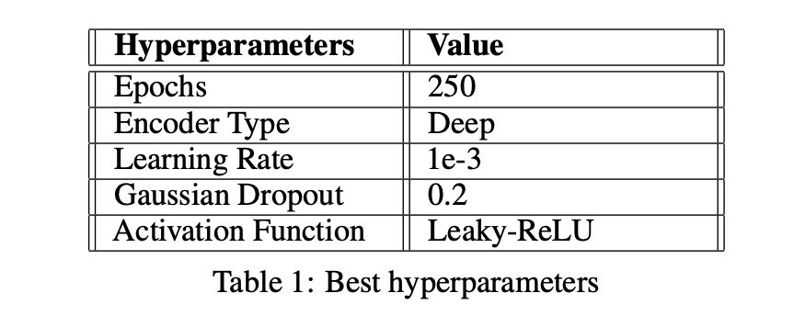

Slide 24
Comparison with Existing Blind Unmixing Models
The final abundance maps obtained for images from the network were compared with the existing blind unmixing models to measure the accuracy of the maps relative to the standardised methods.
Two blind unmixing models were compared, such as UCLS (Unconstrained least-squares) and FCLS(Fully-constrained least-squares). [4]

Slide 25
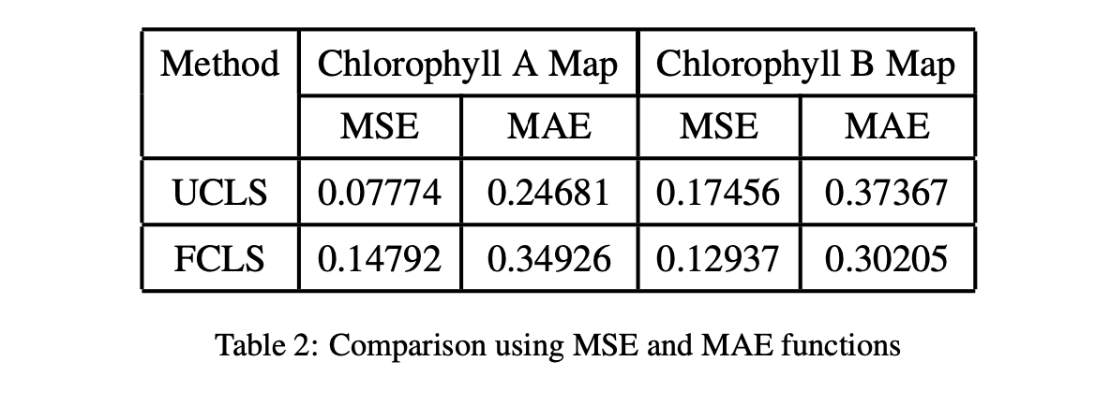

Slide 26
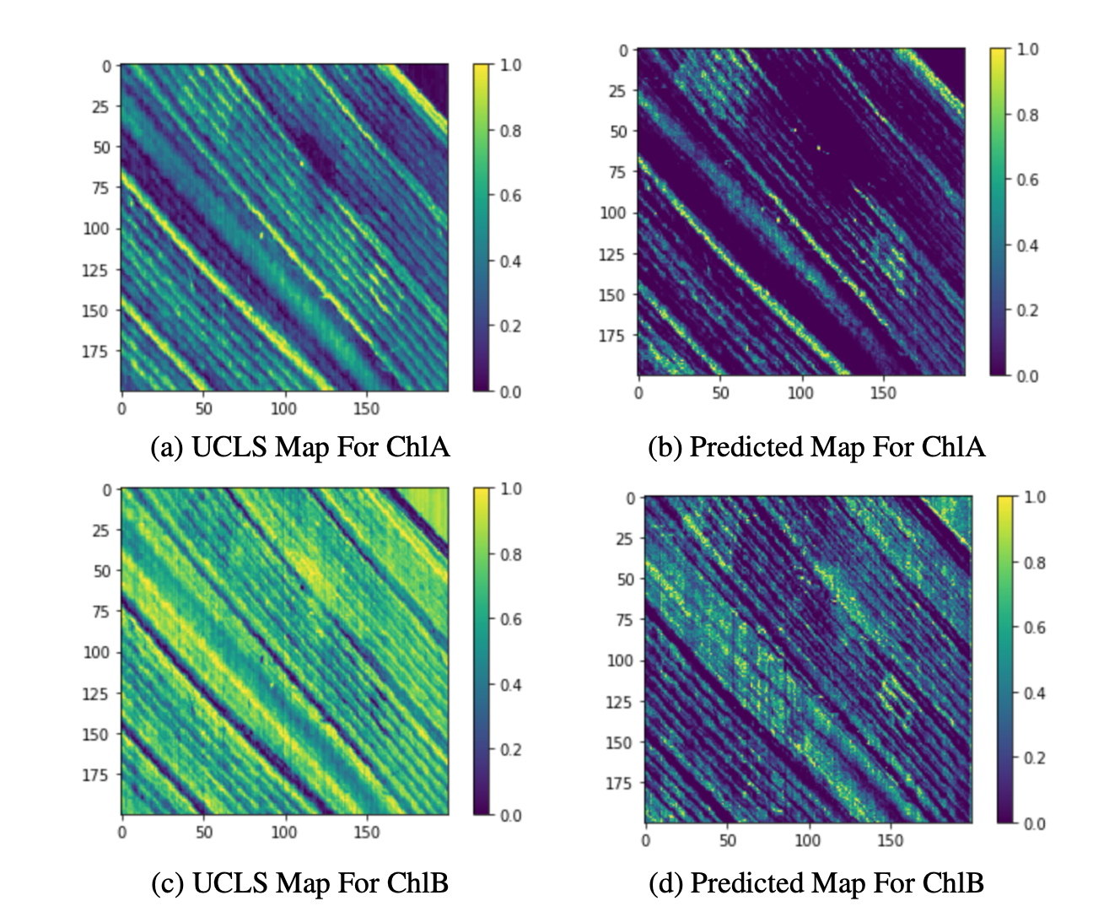
Figure 7: Abundance maps using standardized UCLS method vs estimated abundance maps for an image

Slide 27
Future Work
Improvement of 3_point_loss:
The future work to be carried out as part of the project involves improving the 3_point_loss. The loss function is critical, since it helps us reinforce the network to estimate accurate endmember spectra, which helps in better generalisation of the model.
Network Generalization:
Currently, to obtain optimal results, a new network has to be trained from scratch, since the generalization capabilities of the model have a scope for improvement.
This issue is proposed to be improved by using multiple images for training a generalised model, which can estimate the chlorophyll endmembers and their abundance maps for any given multispectral plant leaf image.

Slide 28
Conclusion
To conclude, the project focussed on devising a procedural AI-based pipeline to unmix Chlorophyll A and B endmembers from plant leaf images, which were taken using a handheld device.
The workflow established was aimed at improving the unmixing accuracy beyond the standardised mathematical methods such as VCA, UCLS and FCLS.
AI based methods are efficient at generalisation , which helps save computational resources and ensures the scalability of the pipeline to further deploy it on hardware devices.

Slide 29
References
Danfeng Hong, Lianru Gao, Jing Yao, Naoto Yokoya, Jocelyn Chanussot, Uta Heiden, and Bing Zhang. Endmember-guided unmixing network (egu-net): A general deep learning framework for self-supervised hyperspectral unmixing. IEEE Transactions on Neural Networks and Learning Systems, 33(11):6518–6531, 2021.
Burkni Palsson, Jakob Sigurdsson, Johannes R Sveinsson, and Magnus O Ulfarsson. Hy- perspectral unmixing using a neural network autoencoder. IEEE Access, 6:25646–25656, 2018.
N. Audebert, B. Le Saux, and S. Lefèvre. Generative adversarial networks for realistic syn- thesis of hyperspectral samples. In 2018 IEEE International Geoscience and Remote Sensing Symposium (IGARSS), July 2018.
C Therien. Welcome to the pysptools documentation, 2021.

